Slide 1
Introducing .Net Core
Yaya David
Snr Software Engineer
Twitter:@yayadavid

Slide 2




.NET Core
Cross-platform
Windows, Linux and macOS
Fast
8x faster than Node.js in TechEmpower benchmark
Lightweight
No impact deployment and a modular development model perfect for containers
Open source
Runtime, libraries, compiler, languages and tools developed in the open in GitHub

Slide 3
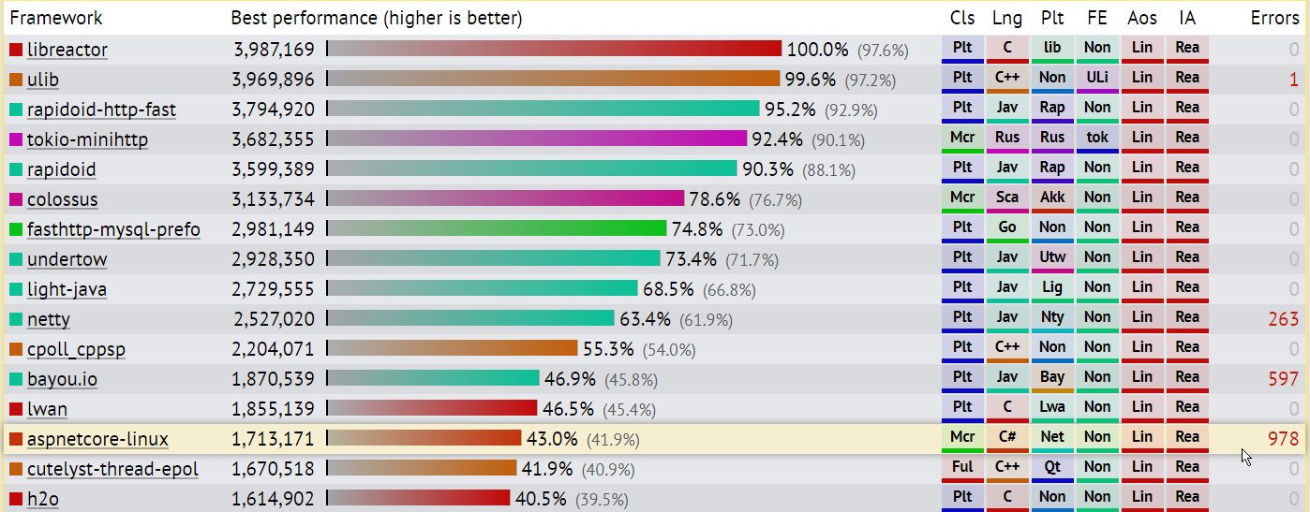
TechEmpower Framework Benchmarks – Round 14 – PlainText
https://techempower.com/benchmarks/

Slide 4
50% of .NET Core contributions are from the community
Google Cloud
Samsung Tizen
RedHat + Other Linux Distros

Slide 5

.NET Open Source Contributions as of 2017

Slide 6







Technical Steering Group
The following companies are helping to drive the future of .NET

Slide 7
Supported OSes
Windows
Windows 7 SP1+, 8.1
Windows 10 Client
Server 2008 R2 SP1+
Server 2016 (incl. Nano)
macOS
Sierra (10.12)
High Sierra (10.13)
Linux
RHEL 7
Fedora 25, 26
Centos 7
Debian 8.7+
Ubuntu 14.04, 16.04, 17.04
Linux Mint 17, 18
openSUSE 42.2+
Oracle Linux 7
SUSE Enterprise Linux 12 SP2+
https://github.com/dotnet/core/blob/master/release-notes/2.0/2.0-supported-os.md

Slide 8
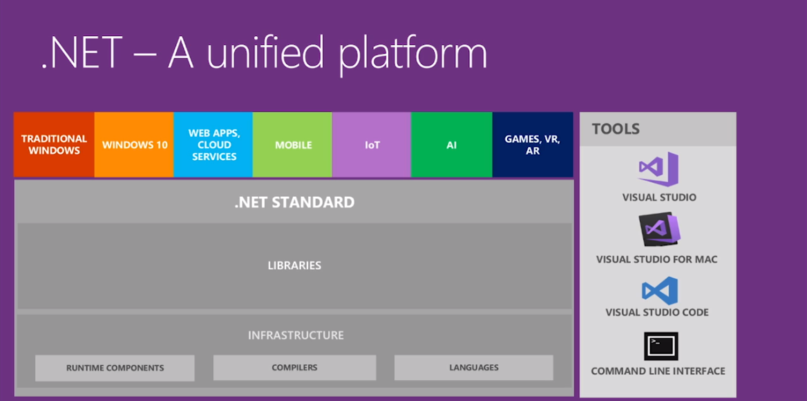

Slide 9
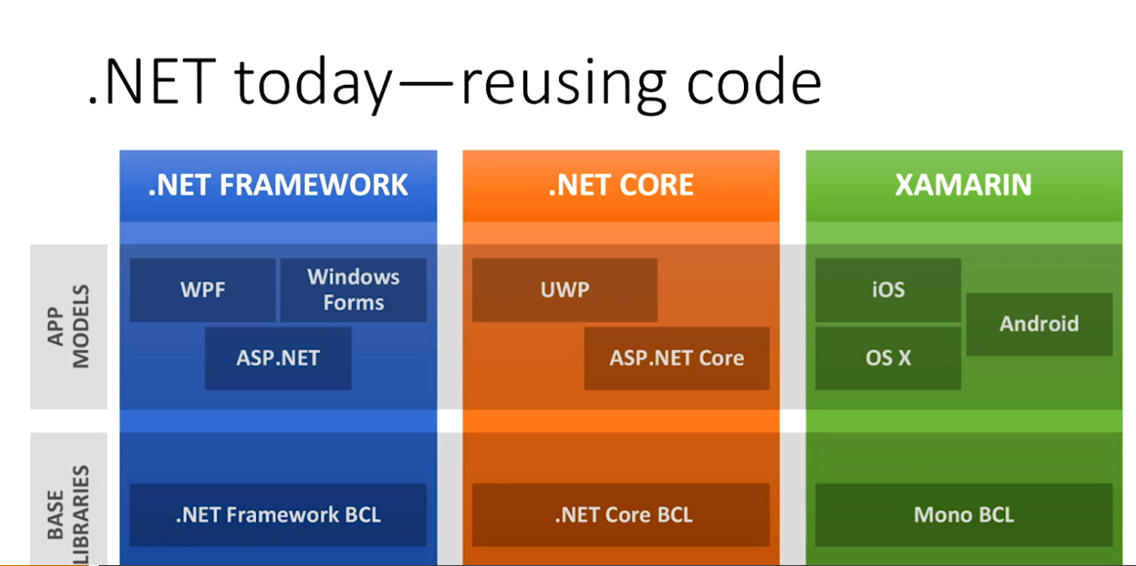
NetStandard

Slide 10
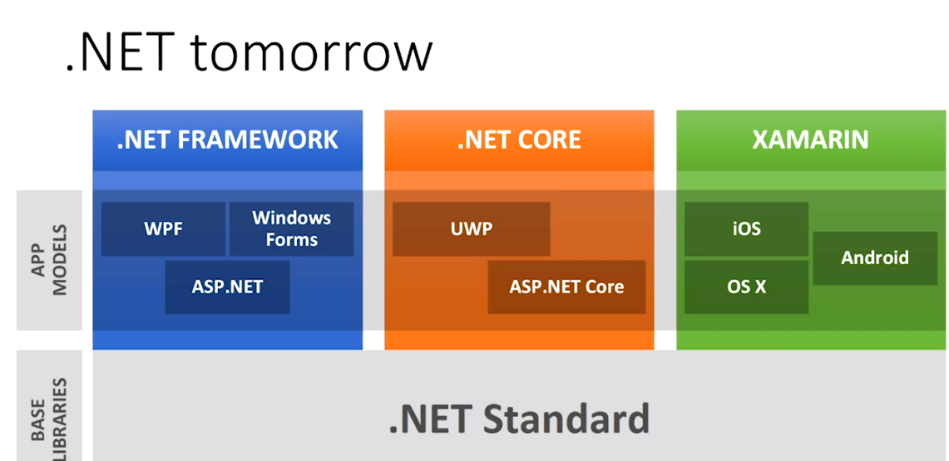

Slide 11
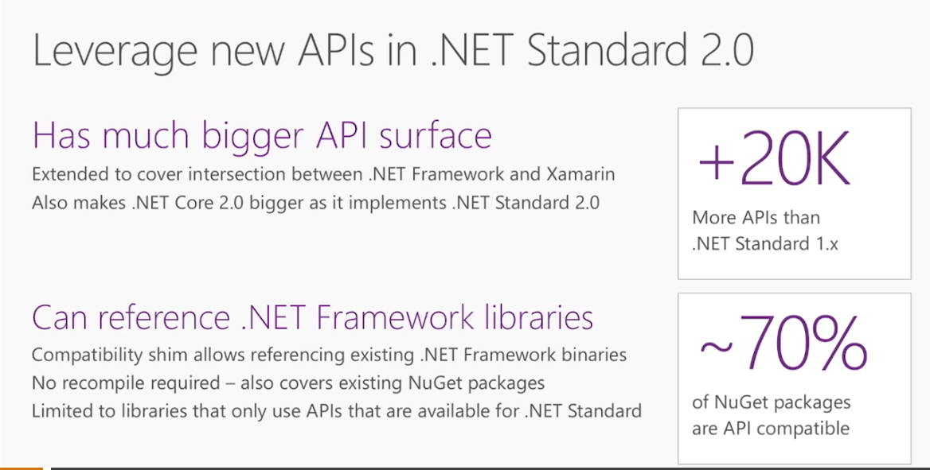

Slide 12




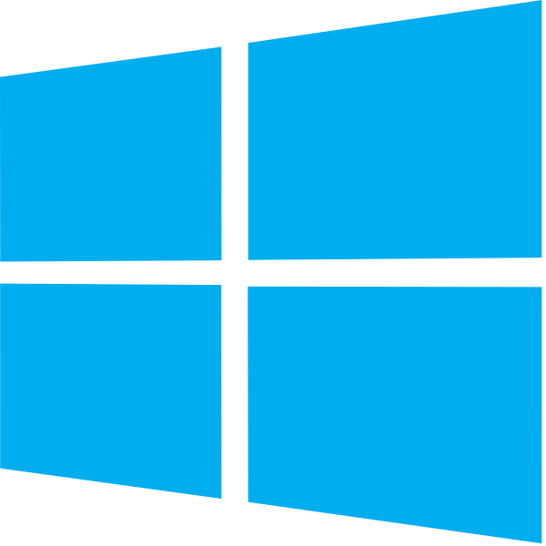



Developer Experiences
Visual Studio for Mac
Visual Studio Code
BYO Text Editor
.NET Core SDK (includes CLI)
Notes:
If you’re on Windows, we recommend Visual Studio
If you’re on Mac, we recommend Visual Studio for Mac
If you prefer a lightweight editor, we recommend Visual Studio Code
If you want to use another text editor, all you need is the .NET Core SDK which includes a CLI

Slide 13
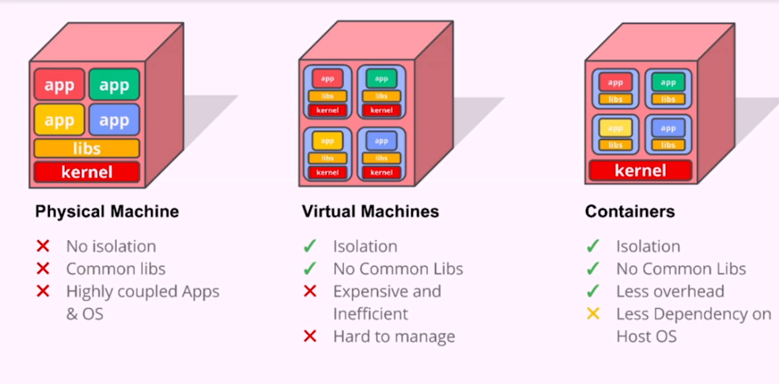
Containerization - Docker

Slide 14
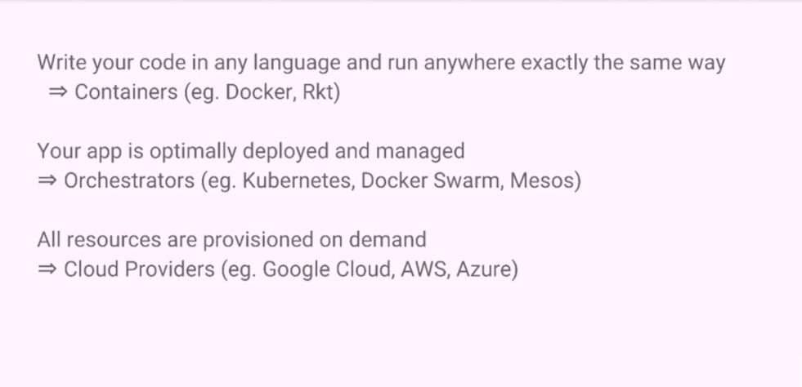
Docker

Slide 15
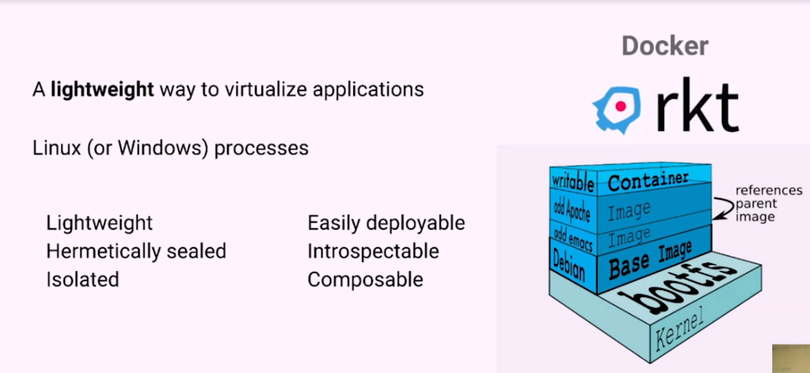
Docker

Slide 16
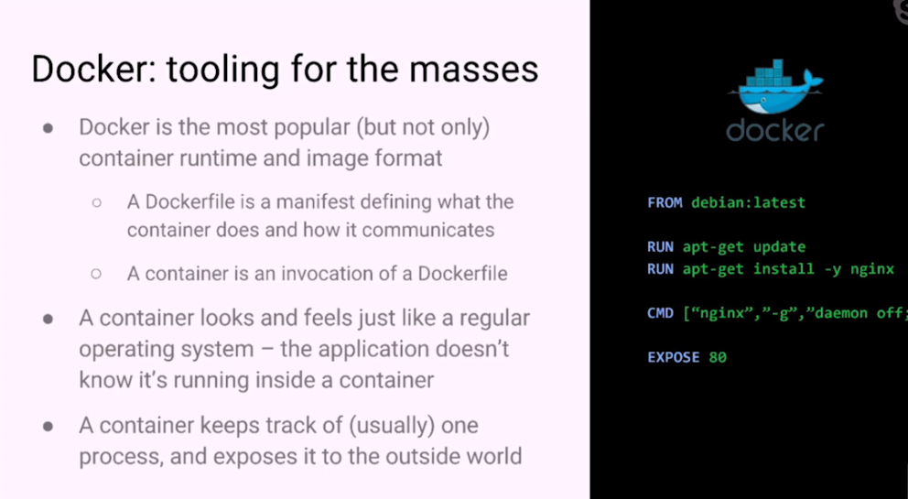
Docker

Slide 17
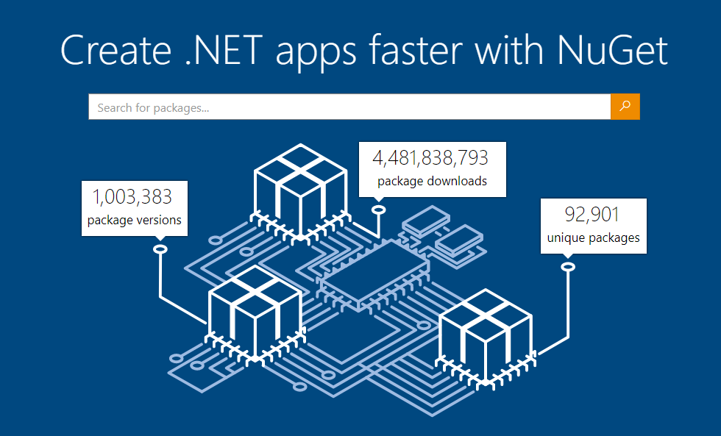
www.nuget.org

Slide 18
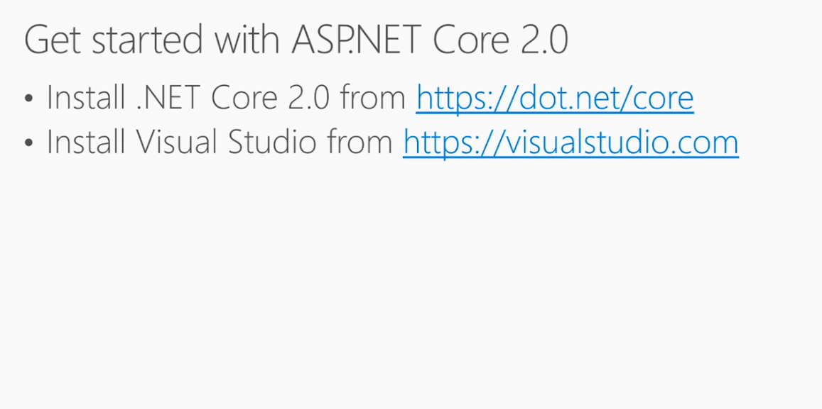
ASP.Net Core

Slide 19
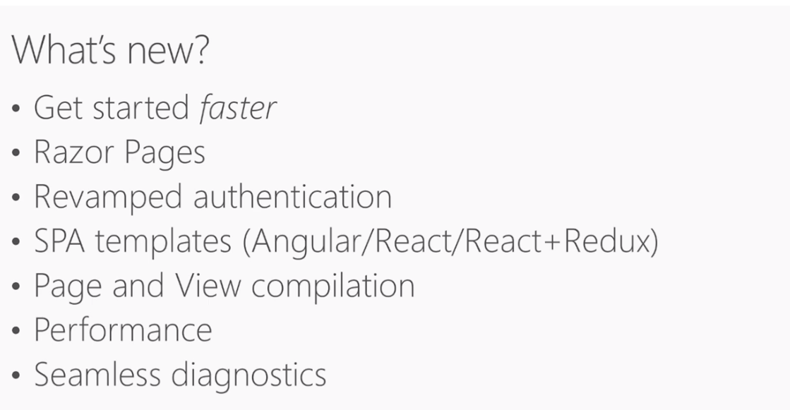
ASP.Net Core

Slide 20
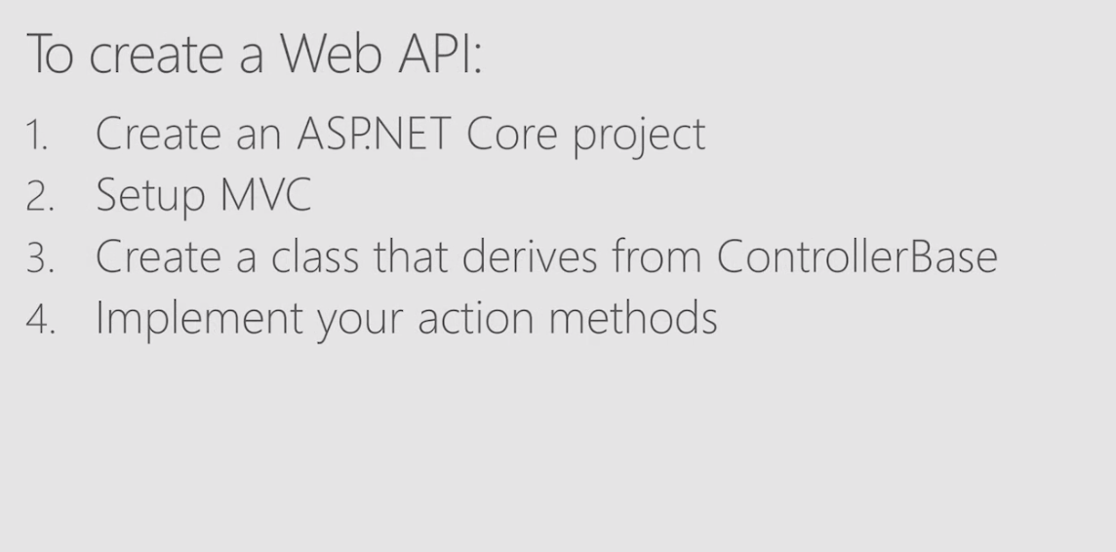
ASP.Net Core

Slide 21
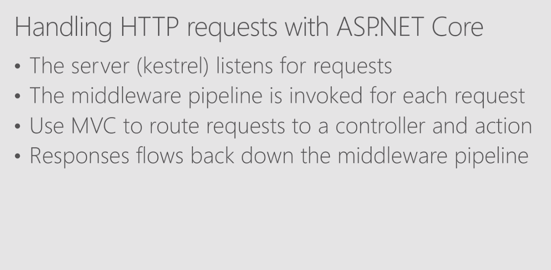

Slide 22
Thank you.
Twitter:@yayadavid

